Slide 1
Computer and Communication Technology (BICT1103)

Slide 2
TOPIC 1: Introduction to Information and Communication Technology
What is a computer?
A Computer is a machine that can do work for people by carrying out instructions given to it.
A sequence of instructions describing how to perform a task is called a program.
The electronic set of each computer can recognize and directly execute a limited set of simple instruction into which all programs must be converted before they can be executed.
Machine language is the computers’ primitive instructions that form a language in which people can communicate with the computer.

Slide 3
Designers of a computer has to simplify the machine language as simple as possible while meeting the computer’s intended use and performance requirements.
They can achieve that by designing the computers with a sequence of abstractions, each building on one bellow it, to reduce complexity and make computer systems more systematic.
This is called Structured Computer Organization.

Slide 4
Structured Computer Organization
There is always a gap between what is convenient for people and what is convenient for computers.
People want to do X while computers want to do Y.
This problem can be solved by having a set of instructions to use that are more convenient for people to use than the built-in instructions.
For example:
Lets say L1 is a set of instructions that humans can write and understand and L0 is a built-in machine instructions that machines understand.

Slide 5
So to execute a program written in L1 , the instructions in L1 have to be replaced by its equivalent sequence of instructions in L0.
The computer then executes the new L0 program instead of the old L1 program.
This technique is called translation.
The other way of executing program written in L1 is by writing a program in L0 that takes programs in L1 as input data and carries them out by examining each instruction in turn and executing the equivalent sequence of L0 instructions directly.
This technique is called interpretation.
The program that carries this out is called an interpreter.

Slide 6
Translation and interpretation are similar as in both the computer carries out instructions in L1 by executing equivalent sequences of instructions in L0.
The only difference is that, in translation, the entire L1 program is first converted to an L0 program, the L1 program is thrown away and then the new L0 program is loaded into the computer’s memory and executed.
In interpretation, after each L1 instruction is examined and decoded, it is carried out immediately.
No translated program is generated. Here, the interpreter is in control of the computer. To it, the L1 program is just data. Both methods, and increasingly, a combination of the two, are widely used.

Slide 7
Rather than thinking in terms of translation or interpretation, it is often simpler to imagine the existence of a hypothetical computer or virtual machine whose machine language is L1.
Let us call this virtual machine M1 (and let us call the machine corresponding to L0, M0).
If such a machine could be constructed cheaply enough, there would be no need for having language L0 or a machine that executed programs in L0 at all.

Slide 8
To make translation or interpretation practical, the languages L0 and L1 must not be ‘‘too’’ different. This constraint often means that L1, although better than L0, will still be far from ideal for most applications.
This result is perhaps discouraging in light of the original purpose for creating L1—relieving the programmer of the burden of having to express algorithms in a language more suited to machines than people. However, the situation is not hopeless.
The obvious approach is to invent still another set of instructions that is more people-oriented and less machine-oriented than L1.
This third set also forms a language, which we will call L2 (and with virtual machine M2). People can write programs in L2 just as though a virtual machine with L2 as its machine language really existed. Such programs can be either translated to L1 or executed by an interpreter written in L1.
The invention of a whole series of languages, each one more convenient than its predecessors, can go on indefinitely until a suitable one is finally achieved. Each language uses its predecessor as a basis, so we may view a computer using this technique as a series of layers or levels, one on top of another, as shown below.

Slide 9
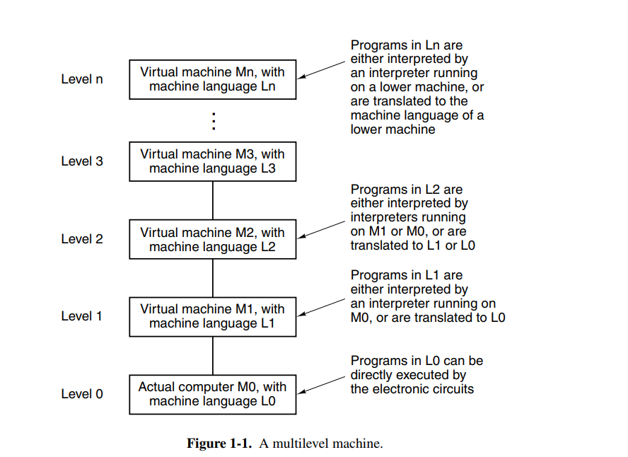

Slide 10
A person who writes programs for the level n virtual machine need not be aware of the underlying interpreters and translators.
The machine structure ensures that these programs will somehow be executed.

Slide 11
The Law of Computers in ICT
Computers play a central role in information and communication technology (ICT) by providing the hardware and software necessary for the creation, storage, processing, and distribution of digital information.
They are essential tools for individuals, businesses, organizations, and governments to communicate, collaborate, and exchange information and data in real-time over local and global networks.
Some of the specific roles that computers play in ICT include:

Slide 12
Communication: Computers enable people to communicate with each other through email, instant messaging, video conferencing, and other online communication tools.
Storage and retrieval of information: Computers are used to store, organize, and retrieve information and data, making it easier to manage large amounts of information and access it quickly.
Data analysis: Computers can analyze large datasets, perform complex calculations, and generate reports that can help organizations make informed decisions.

Slide 13
Automation: Computers are used to automate repetitive tasks and processes, increasing efficiency and reducing errors.
Education and training: Computers are used in education and training to provide access to online resources, distance learning, and interactive educational materials.
Entertainment: Computers are used for gaming, streaming videos and music, and other forms of digital entertainment.

Slide 14
History of Computers
Hundreds of different kinds of computers have been designed and built during the evolution of the modern digital computer.
Most have been long forgotten, but a few have had a significant impact on modern ideas.
In this section we will give a brief sketch of some of the key historical developments in order to get a better understanding of how we got where we are now.

Slide 15
The Zeroth Generation—Mechanical Computers (1642–1945)
The first person to build a working calculating machine was the French scientist Blaise Pascal (1623–1662), in whose honor the programming language Pascal is named.
This device, built in 1642, when Pascal was only 19, was designed to help his father, a tax collector for the French government.
It was entirely mechanical, using gears, and powered by a hand-operated crank.
Pascal’s machine could do only addition and subtraction operations, but thirty years later the great German mathematician Baron Gottfried Wilhelm von Leibniz (1646–1716) built another mechanical machine that could multiply and divide as well.

Slide 16
The First Generation—Vacuum Tubes (1945–1955)
The first generation of computers used vacuum tubes for electronic circuits.
They were large and expensive, consumed a lot of power, and generated a lot of heat.
Examples include:
ENIAC(Electronic Numerical Integrator And Computer).
EDVAC(Electronic Discrete Variable Automatic Computer).
IBM 701.
It was realized that programming computers with switches and cables was slow and inflexible.
Discoveries were made that programs and data could be stored in digital form in the computer's memory and that parallel binary arithmetic could replace the serial decimal arithmetic used by ENIAC.
This led to the development of the von Neumann machine, which is still the basis of modern digital computers.
Herman Goldstine and others also made significant contributions to the design.

Slide 17
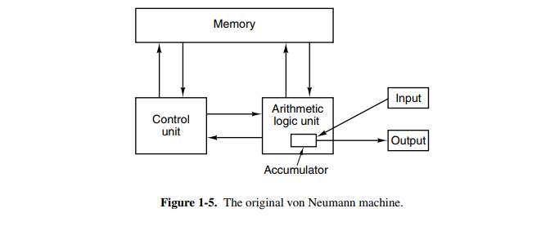

Slide 18
The von Neumann machine had five basic parts:
Memory: Stores program instructions and data. CPU fetches instructions from memory and loads them into the control unit.
Control Unit: Manages flow of instructions and data within the CPU. Retrieves instructions from memory and sends them to the ALU for execution. Determines which instructions to execute and in what order.
Arithmetic Logic Unit (ALU): Performs mathematical and logical operations on data. Receives input data from CPU's registers and stores results in another register for future use.
Input and Output (I/O): Allows computer to interact with outside world. Input devices, such as keyboards and mice, provide data to computer. Output devices, such as displays and printers, present results to users. Connected to CPU via input/output controllers that manage data transfer between I/O devices and memory.

Slide 19
The Second Generation—Transistors (1955–1965)
The second generation of computers used transistors instead of vacuum tubes.
This made them smaller, faster, more reliable, and less expensive. Examples include IBM 7094, UNIVAC 1108, and DEC PDP-8.
The first transistorized computer was built at M.I.T.’s Lincoln Laboratory, a 16-bit machine along the lines of the Whirlwind I.
It was called the TX-0 (Transistorized eXperimental computer 0).

Slide 20
The Third Generation—Integrated Circuits (1965–1980)
The third generation of computers used integrated circuits, which allowed for even greater miniaturization and increased processing power than the transistorized predecessors.
The invention of the silicon integrated circuit by Jack Kilby and Robert Noyce (working independently) in 1958 allowed dozens of transistors to be put on a single chip.
Examples include IBM System/360, DEC PDP-11, and VAX-11.
Another major discovery in this era is multiprogramming which allowed having many programs in a memory at once.

Slide 21
The Fourth Generation—Very Large Scale Integration (1980)
Computers of fourth generation used Very Large Scale Integrated (VLSI) circuits.
VLSI enables hundreds of thousands of transistors on a single chip.
This development soon led to smaller and faster computers.
The prices of the computer dropped that allowed even an individual to own his or her own computer.

Slide 22
The Fifth Generation—Low-Power and Invisible Computers (1980 - present)
In this era, VLSI technology became ULSI (Ultra Large Scale Integration) technology, resulting in the production of microprocessor chips having ten million electronic components.
This generation is based on parallel processing hardware and AI (Artificial Intelligence) software.
AI is an emerging branch in computer science, which interprets the means and method of making computers think like human beings.
All the high-level languages like C and C++, Java, .Net etc., are used in this generation.

Slide 23
CPU and Main Memory
The CPU (Central Processing Unit) is the ‘‘brain’’ of the computer.
Its function is to execute programs stored in the main memory by fetching their instructions, examining them, and then executing them one after another.
The components of a simple bus-oriented computer are connected by a bus.
A bus is a collection of parallel wires for transmitting address, data, and control signals.

Slide 24
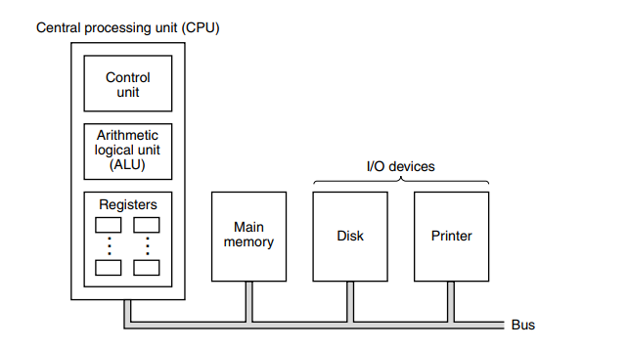
The organization of a simple computer with one CPU and two I/O devices.

Slide 25
The CPU is composed of several distinct parts:
Control Unit (CU) - responsible for fetching instructions from main memory and determining their type.
Arithmetic Logic Unit (ALU) - performs operations such as addition and Boolean AND needed to carry out the instructions.
Registers (memory) – small, high speed memory used to store temporary results and certain control information. Registers can be read and written to at high speed since they are internal to CPU.

Slide 26
The most important register in CPU is Program Counter(PC).
Program Counter (PC) points to the next instruction to be fetched for execution.
Another important register is the Instruction Register (IR).
Instruction Register holds the instruction currently being executed.
Most computers have numerous other registers as well, some have general purpose as well as some for specific purpose.

Slide 27
CPU Organization
The internal organization of a simple von Neumann CPU is called data path.
It consists of registers, the ALU and several buses connecting the pieces.

Slide 28
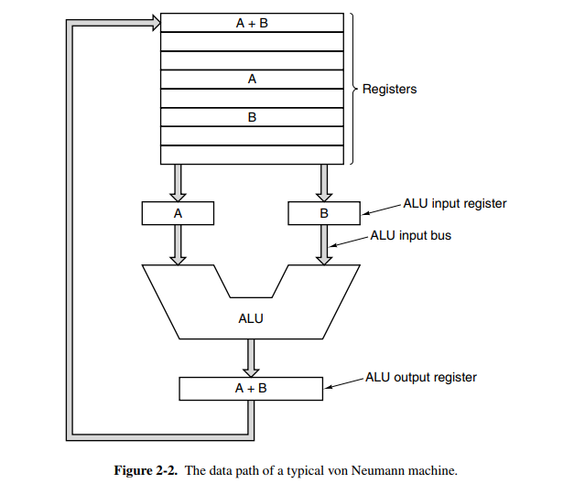

Slide 29
The registers feed into two ALU input registers, labeled A and B in the figure.
These registers hold the ALU input while the ALU is performing some computation.
The ALU itself performs addition, subtraction, and other simple operations on its inputs, thus yielding a result in the output register.
This output register can be stored back into a register.

Slide 30
Most instructions can be divided into one of two categories:
Register-memory - allow memory words to be fetched into registers, where, for example, they can be used as ALU inputs in subsequent instructions.
Register-register - fetches two operands from the registers, brings them to the ALU input registers, performs some operation on them (such as addition or Boolean AND), and stores the result back in one of the registers.
The process of running two operands through the ALU and storing the result is called the data path cycle and is the heart of most CPUs.

Slide 31
Instruction Execution
The CPU executes each instruction in a series of small steps.
Roughly, the steps are as follows:
Fetch the next instruction from memory into the instruction register.
Change the program counter to point to the following instruction.
Determine the type of instruction just fetched.
If the instruction uses a word in memory, determine where it is.
Fetch the word, if needed, into a CPU register.
Execute the instruction.
Go to step 1 to begin executing the following instruction.
This sequence of steps is frequently referred to as the fetch-decode-execute cycle. It is central to the operation of all computers.

Slide 32
Microcomputer System Unit
Microcomputer is also known as Personal Computer (PC).
Microcomputers are the common type of computers that are mostly used by individuals and small businesses nowadays.
Microcomputer system unit has the following main parts:
The Motherboard – the central circuit board that connects all other components.
The CPU – The ‘Brain’ of the computer that performs most of the calculations and logic operations.
Memory (RAM) – a volatile storage device that temporarily stores data and instructions.

Slide 33
Storage Devices – non-volatile storage devices that store data permanently such as HDDs (Hard-Disk Drives) and SSDs (Solid-State Drives).
Power Supply – converts AC power to DC power for the computer’s internal components.
Expansion Slots – openings in the motherboard that allow additional components, such as RAMs, to be added to the system.
Input/Output ports – openings that allow peripheral devices, such as printers, keyboards, and mice, to be connected to the computer.

Slide 34
Input hardware
Input hardware are physical devices that are used to enter data into the computer system.
Examples of such devices are:
Keyboard - used for typing data into a computer. It has a set of keys that are used to type letters, numbers, and symbols.
Mouse - pointing device used to move a cursor on the computer screen. It has one or more buttons that can be clicked to perform actions on the screen.
Scanner - device that converts physical documents or images into digital format. It is commonly used for scanning photos, documents, and other paper-based materials.
Touchscreen - an input device that allows users to interact with a computer by touching the screen directly with their fingers or a stylus. It is commonly used in smartphones, tablets, and other mobile devices.
Microphone - an input device used to record audio. It can be used for voice recognition, speech-to-text, and other applications.

Slide 35
Output Devices
Output devices are physical devices used to display or present data processed by a computer system.
Here are some output devices:
Monitor - a display screen used to output visual information from a computer. It displays text, images, and videos in different resolutions and sizes.
Printer - a device used to output hard copies of digital documents, images, and other materials. It can print in black and white or color, and in various sizes and formats.
Speakers - devices used to output audio. They can produce sound in different frequencies and volumes, and are commonly used for music, videos, and other multimedia applications.
Projector - used to display images and videos on a large screen or wall. It is commonly used for presentations, movies, and other visual applications.
Headphones - output devices used to output audio directly to the user's ears. They can be wired or wireless, and are commonly used for music, videos, and other multimedia applications.

Slide 36
Storage Media
Storage media are physical devices used to store and retain digital data for future use.
Storage media can be volatile or non-volatile
Volatile Storage Devices: Volatile storage devices require power to maintain the data stored in them.
When the power is turned off, the data is lost. Examples of volatile storage devices include Random Access Memory (RAM) and cache memory.
RAM is commonly used as a temporary storage device for data and programs that are actively being used by the computer's processor.

Slide 37
Non-Volatile Storage Devices: Non-volatile storage devices can retain data even when power is turned off. They are commonly used for long-term storage of data and programs.
Examples of non-volatile storage devices include hard disk drives (HDD), solid-state drives (SSD), flash memory, optical storage media (such as CDs and DVDs), and magnetic tape. These devices use different technologies to store data, such as magnetic, optical, or semiconductor-based memory.

Slide 38
Software and Applications
In addition to hardware, a computer needs software to function.
Are programs that control or maintain the operations of the computer and its devices.
Software or programs, consists of electronic instructions that tell the computer how to perform a task.
A program installed in the computer that contains a set of instructions executed by the computer in order to perform a task.

Slide 39
Types of software
System Software - Programs that control or maintain the operations of the computer and its devices.
Examples include
Operating System - controls and manages the hardware connected to a computer, OS - provides an interface that helps users to interact with the computer. Examples include Windows XP, 7,8,10, Mac OS, Linux, Android etc
Utility programs – A program that performs a very specific task related to managing system resources. Help to perform maintenance or correct problems with a computer system. Examples include anti-viruses.
Application software: Programs that perform specific tasks for users. Examples include Spreadsheets, MS word etc

